Slide 1
Introduction to Data Visualization
Morine Amutorine BS, Lehel Csató PhD, Elaine Nsoesie PhD

Slide 2
Instructor introductions …
Contacts:
Morine - morine.amutorine@one.un.org /
Elaine - onelaine@bu.edu / @ensoesie
Lehel - lehel.csato@cs.ubbcluj.ro /

Slide 3
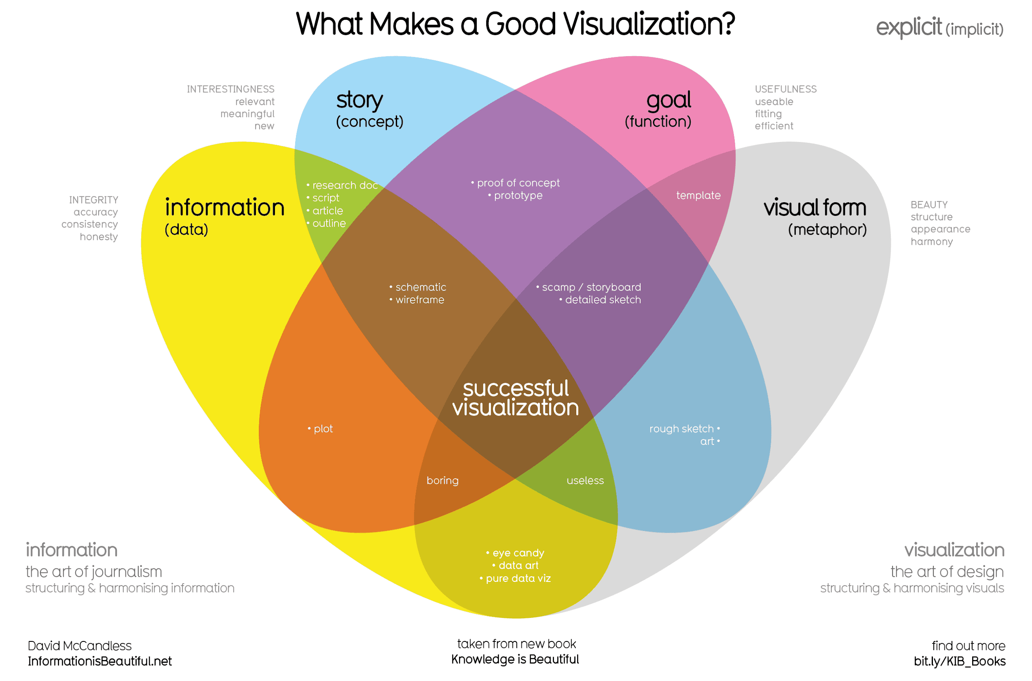
Why visualize data?
A picture is worth a thousand words
It is easier to remember pictures than text
Useful for understanding data
Can summarize large amounts of complex data

Slide 4
Visualization in Data Science can be used to:
Explore data
Analyze data
Communicate findings
Quickly draw attention to key messages

Slide 5
How to use visualizations to communicate effectively?

Slide 6
Decide on what your visualization should convey
1
FOCUS ON THE DATA
The style and structure of your visualization will depend on its purpose
Design for a specific audience
Tell a good story with a clear message
Notes:
How much data to display for the audience?

Slide 7
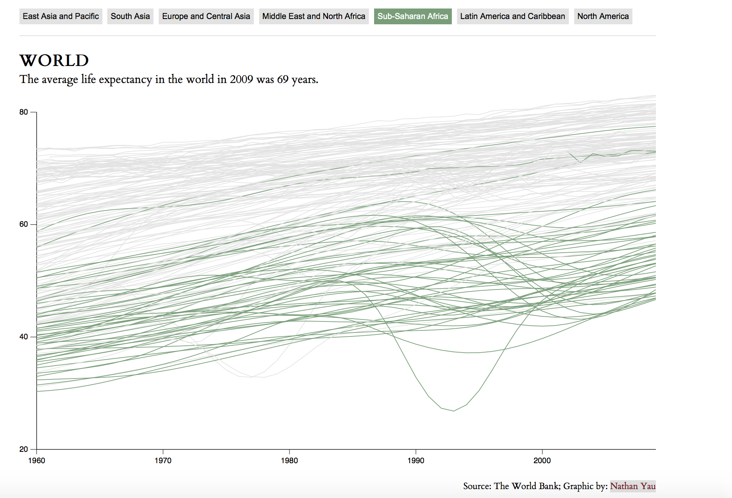
Use color and size to highlight and suppress information
2

Slide 8

Notes:
How long does it take to spot the odd one? https://venngage.com/blog/how-to-pick-colors/

Slide 9

Notes:
How long does it take to spot the odd one? https://venngage.com/blog/how-to-pick-colors/

Slide 10

Notes:
How long does it take to spot the odd one? https://venngage.com/blog/how-to-pick-colors/

Slide 11
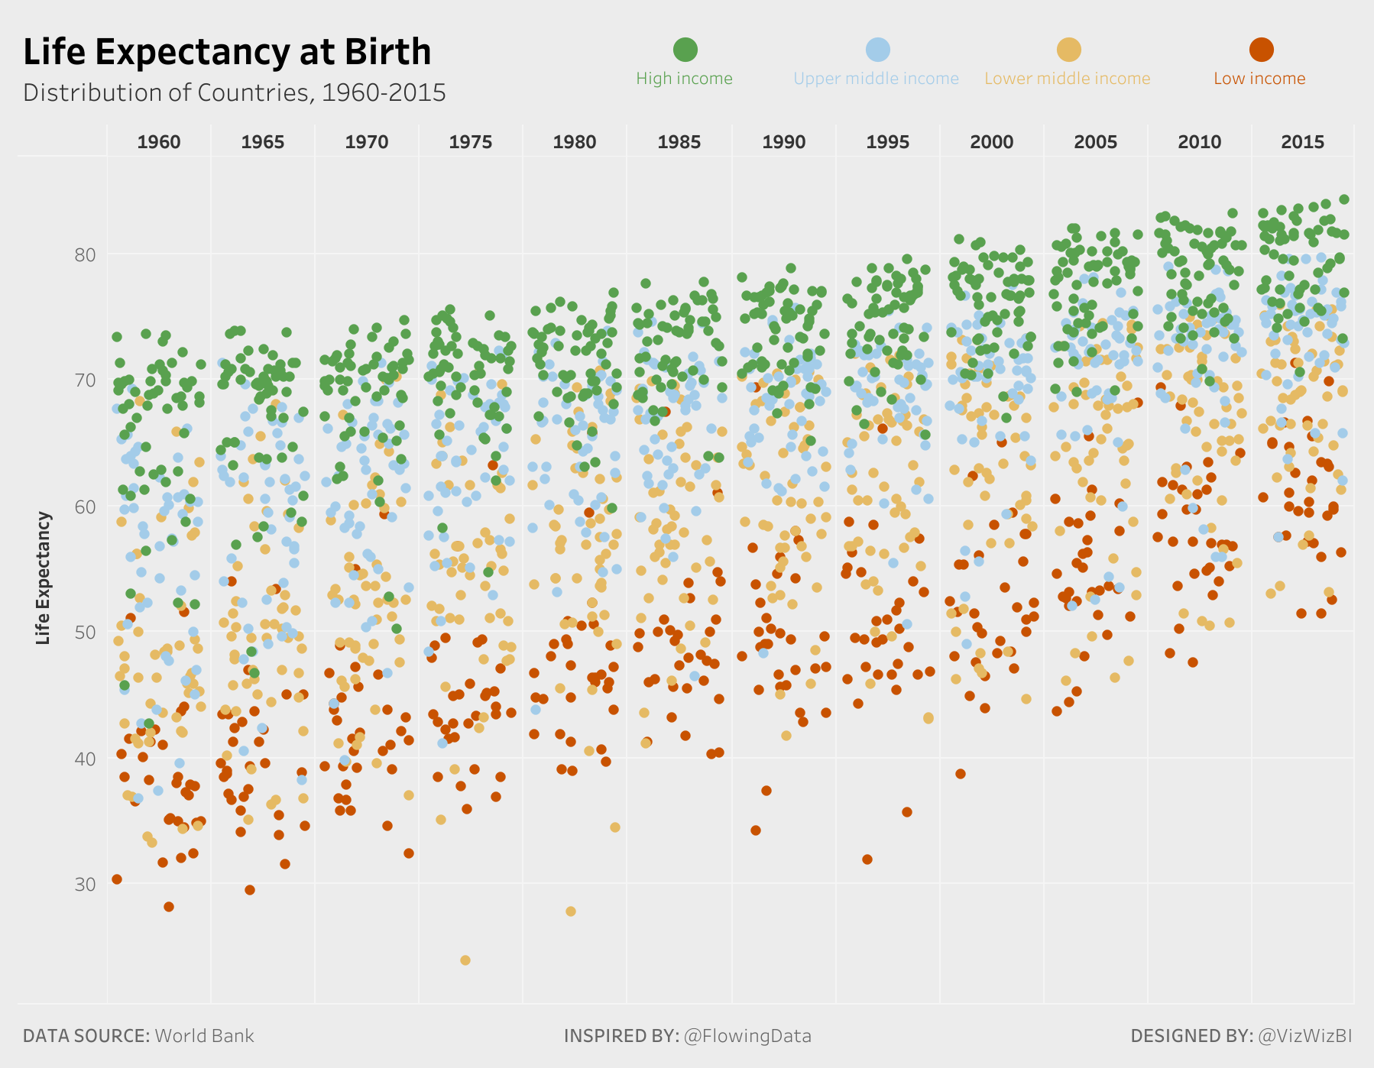
Use length and position to express quantitative information. Use color for categorical information
3
Scatter plots and bar charts allow for more accurate comparison of information over time compared to pie charts

Slide 12
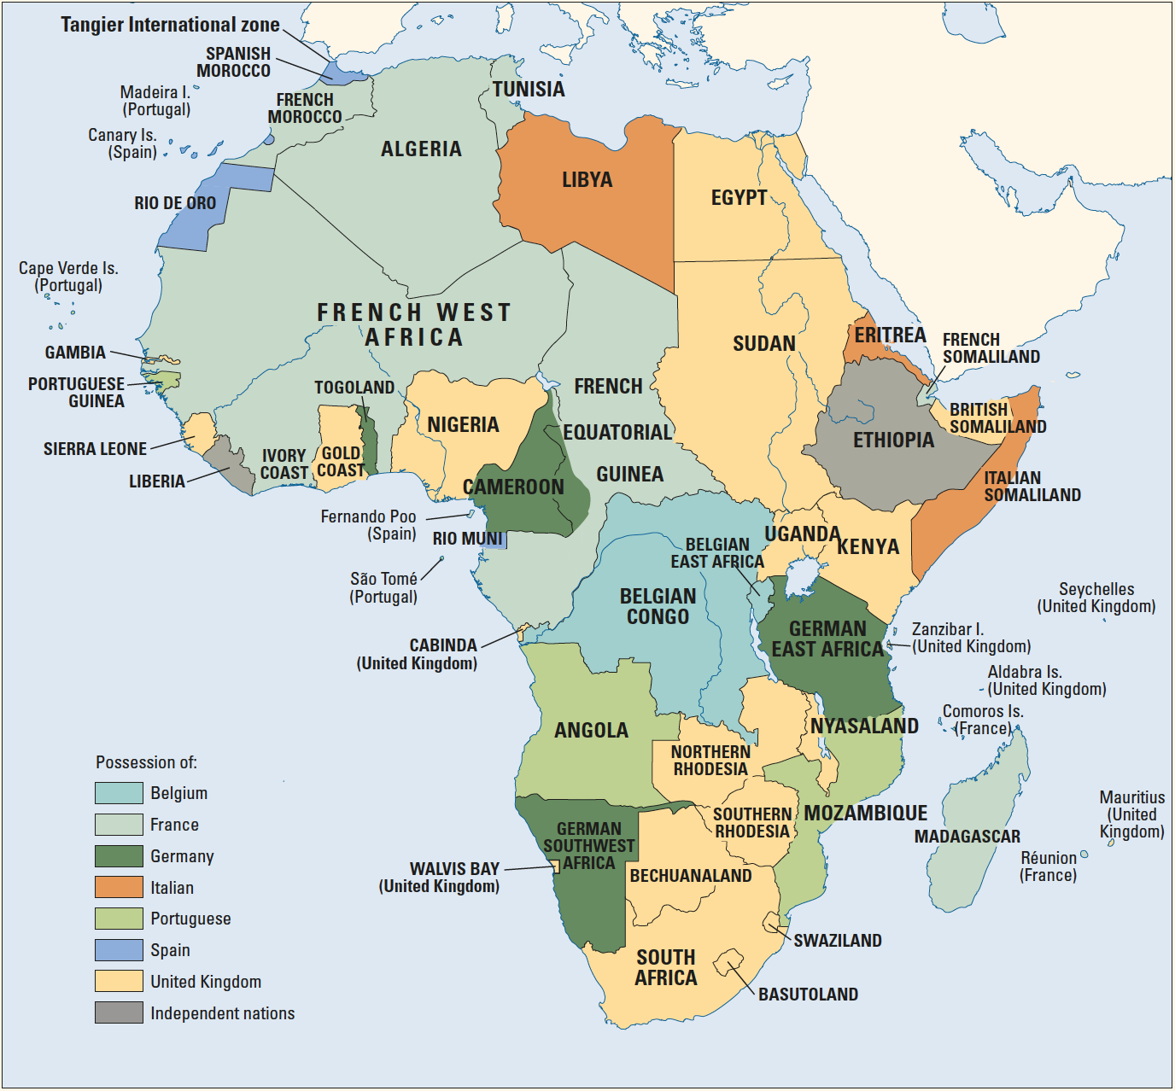
Think carefully about color selection and usage
4
Use color to create groupings
Add a single color to a black and white image
Use black and white to add contrast to an image with a single color gradient
https://africaindata.org/#/3
Notes:
Don’t use every color available. Example - a century ago most of Africa was colonized by European powers

Slide 13
Think carefully about color selection and usage
4
Some colors have pre-established meanings
Consider those with color blindness
Red
Stop
Dangerous
Hot
Green
Moving
Money
Plants
Blue
Water
Cool
Safe

Slide 14
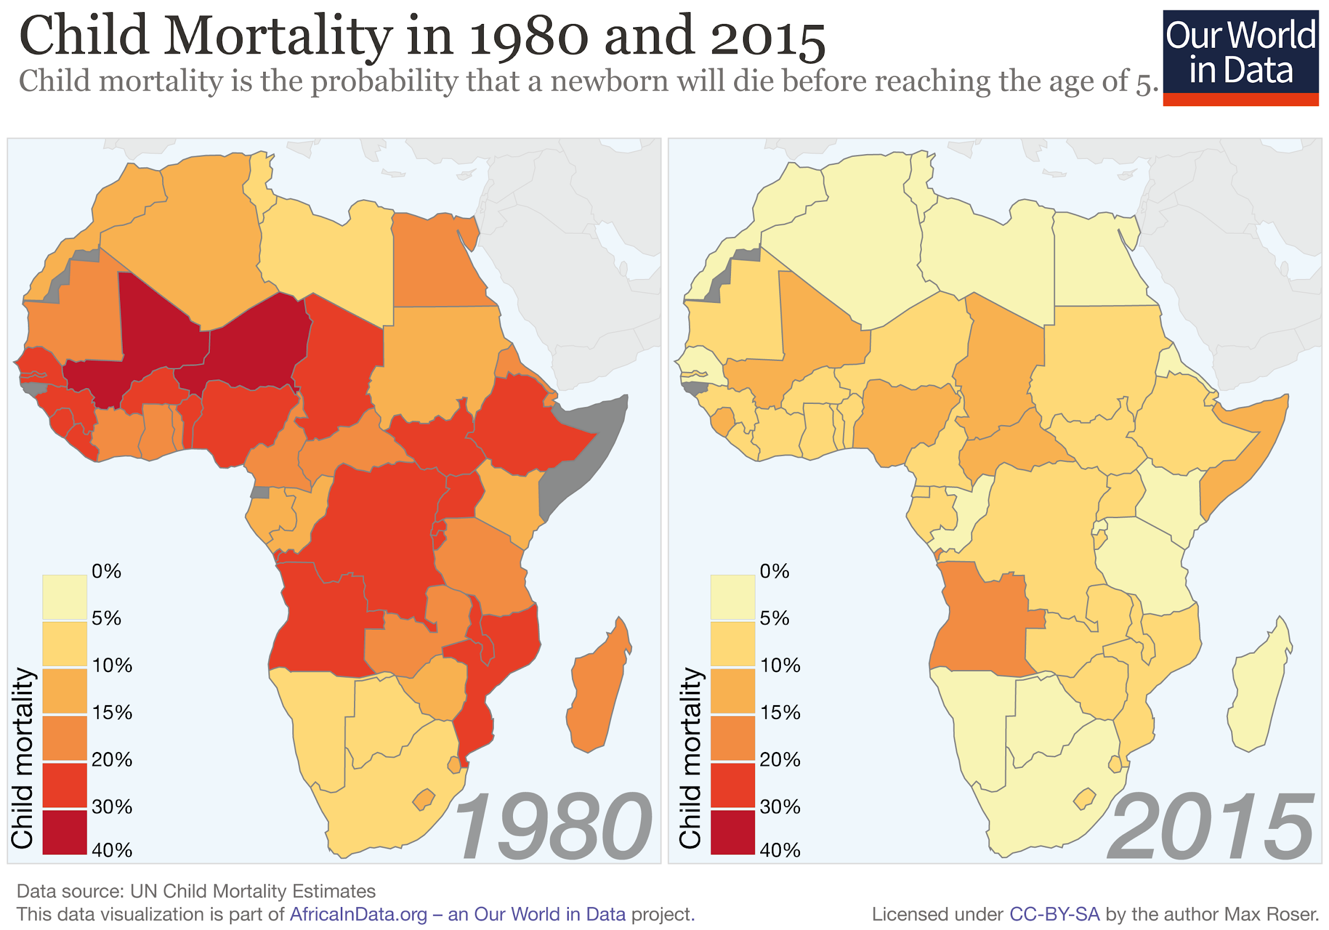
Use all available space and proper scales
5
Scale does not always have to include zero
Optimize the ratio between plot objects to capture accurate relationships
Transform data to a different scale e.g. use log scale to show percentage change over time

Slide 15
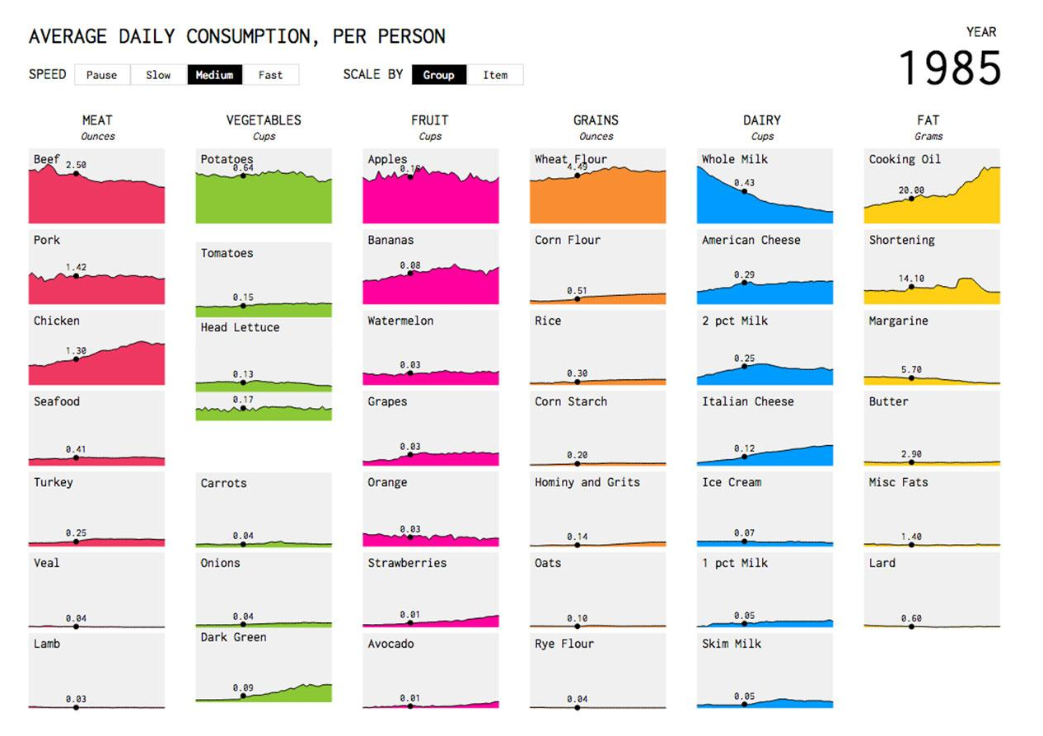
Use text and labels to improve interpretation
6
Use meaningful titles
Label axis, as needed
Add texts directly to the image - do not always rely on legends
Lines should not obstruct points
Use colors (e.g. light grey) and weight that lessen focus on tick marks and grids
Notes:
Image from: https://flowingdata.com/2016/05/17/the-changing-american-diet/

Slide 16
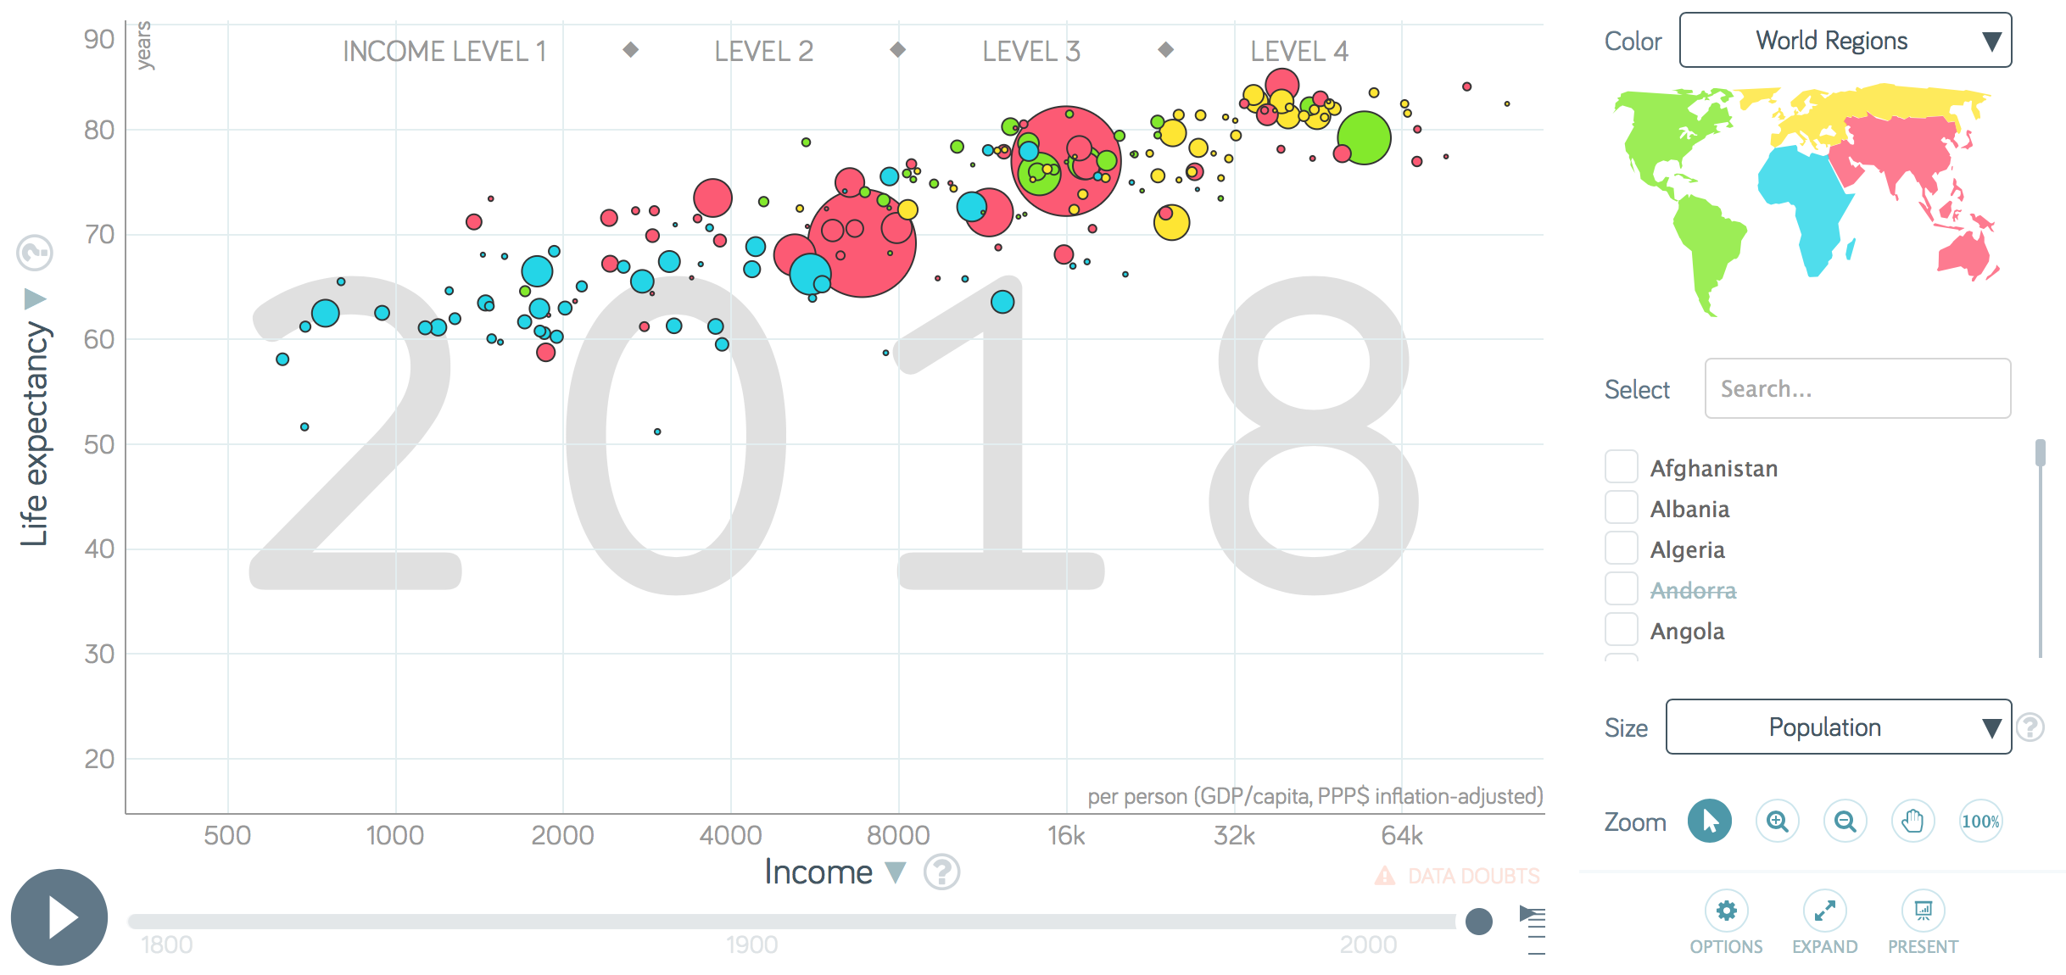
Balance complexity and clarity
7
GapMinder (https://www.gapminder.org/tool)
Notes:
Image from GapMinder. Use interactive visualizations but don’t rely on it heavily. Don’t hide important details behind interactive elements. Use interactive visualize to integrate additional details to allow further exploration by people who are interested.

Slide 17
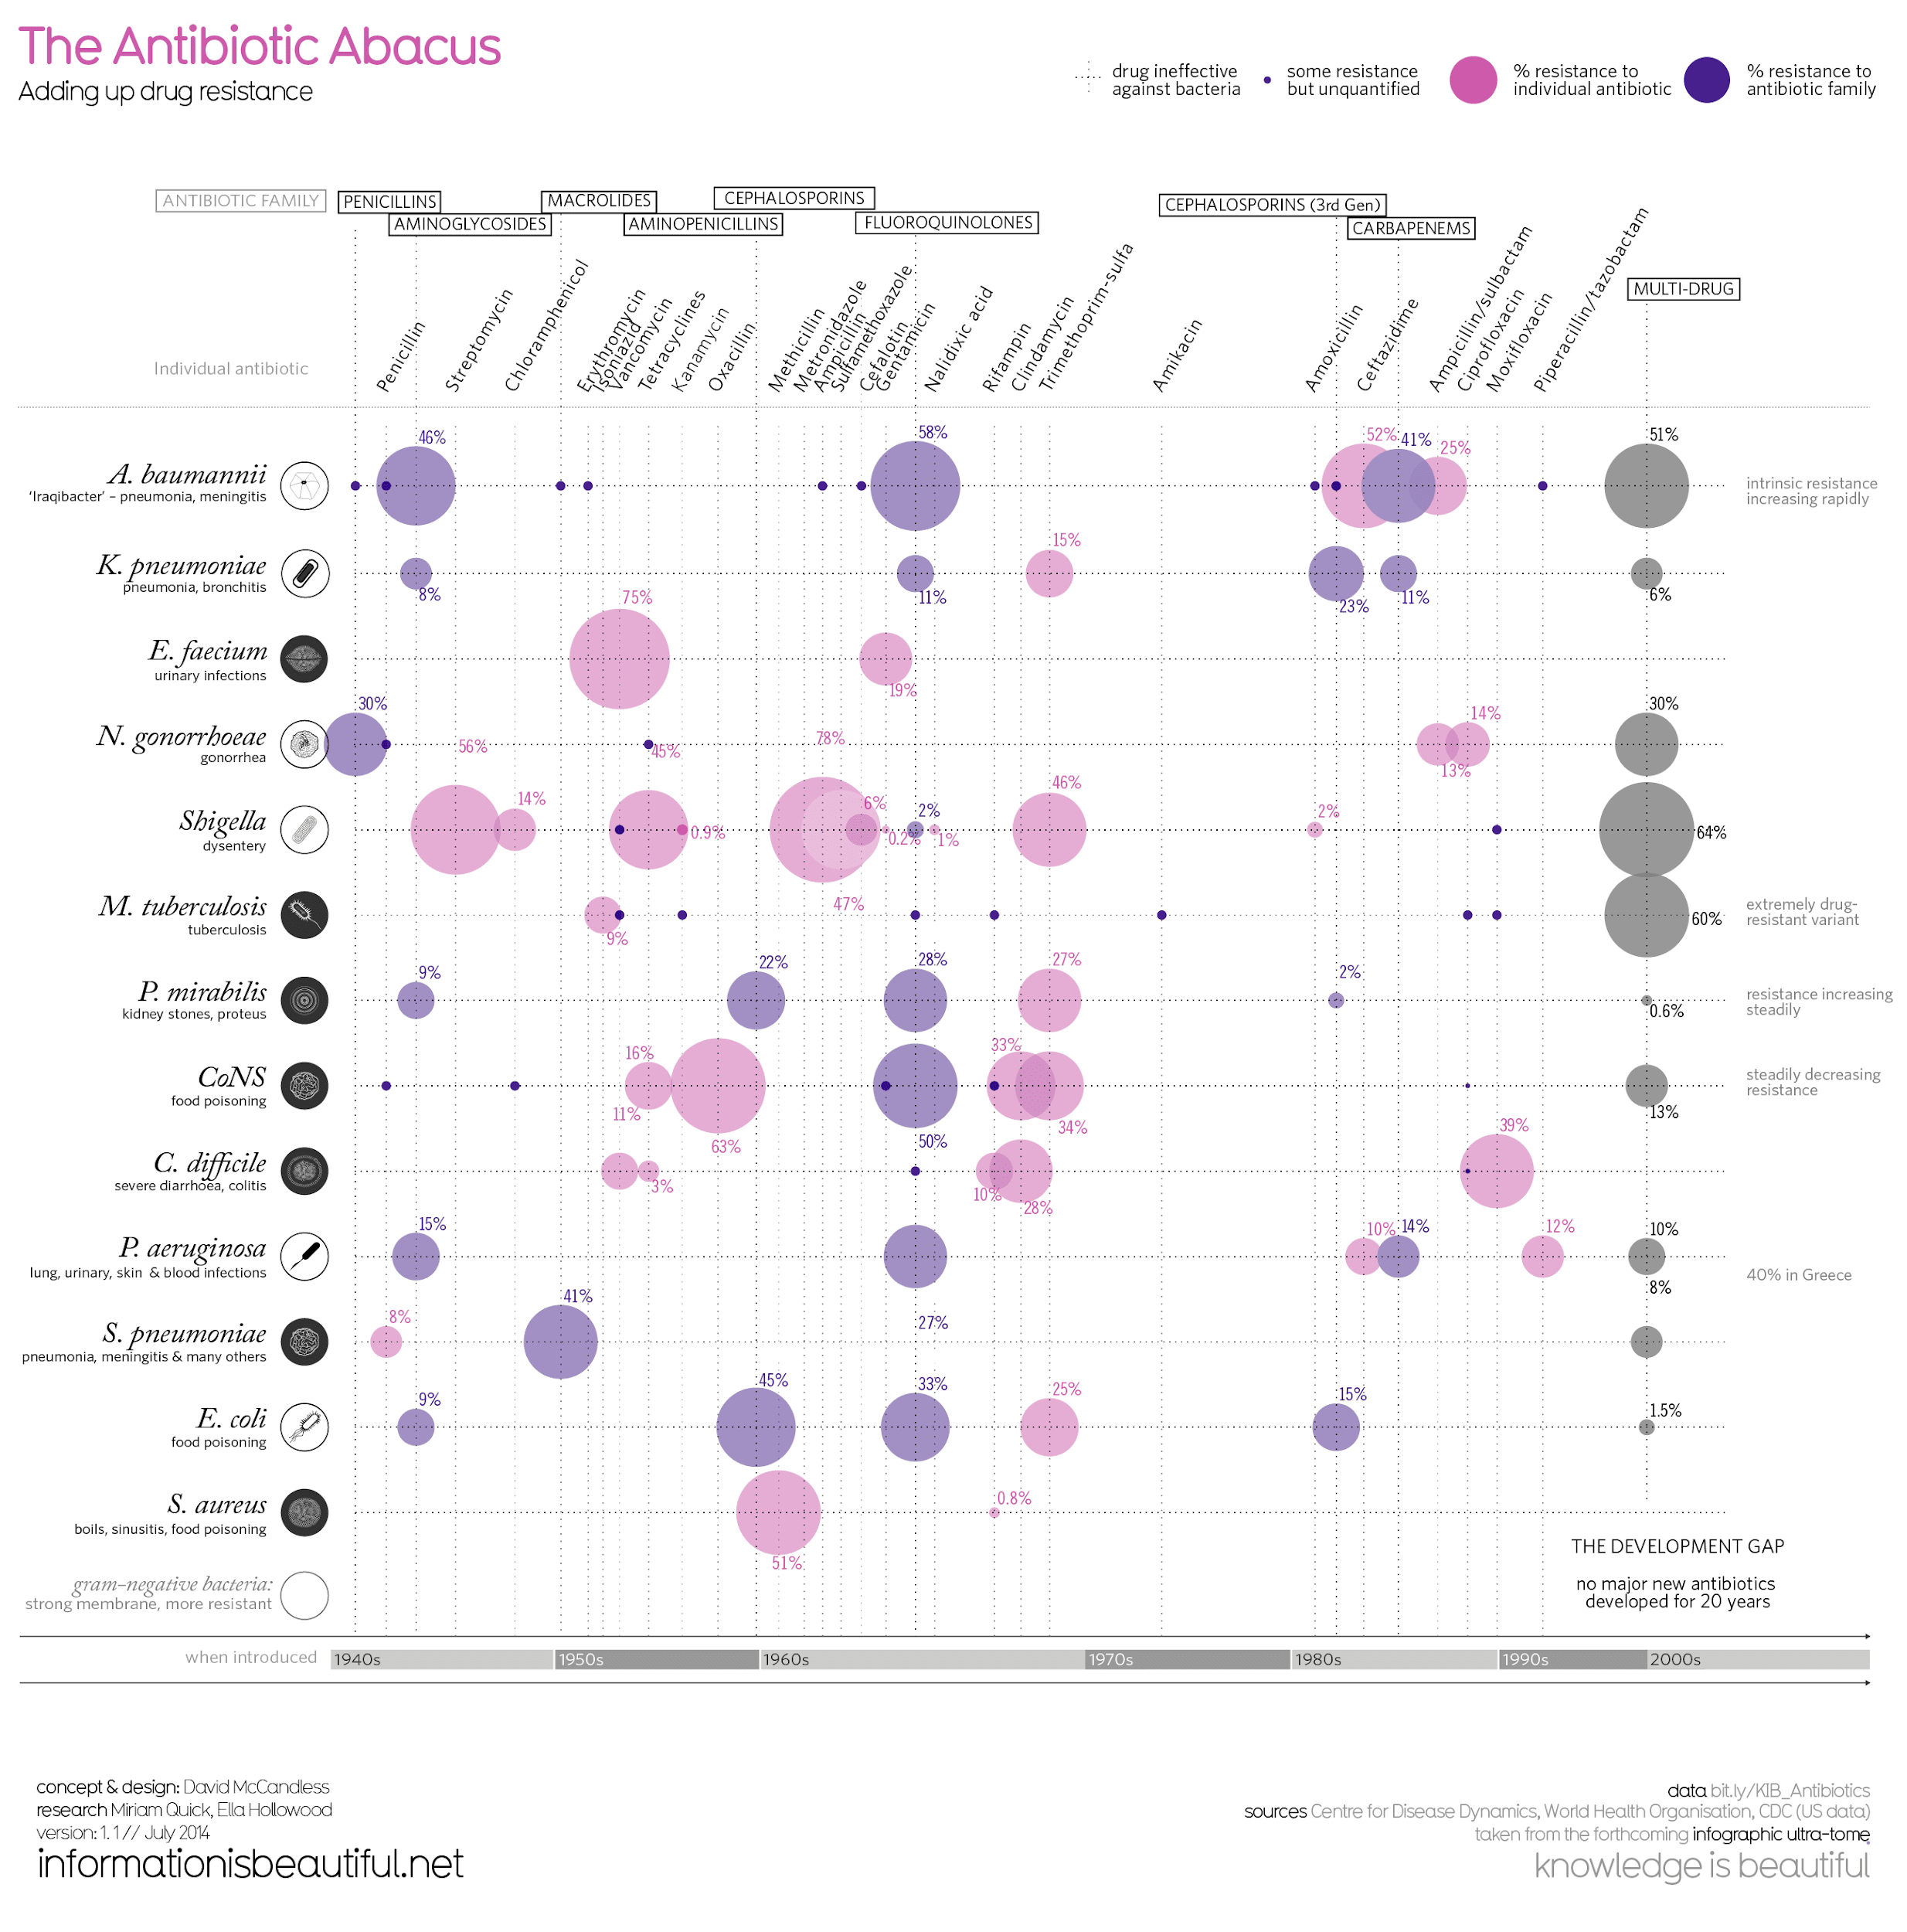
Balance complexity and clarity (infographics)
7
Templates and examples available online
Can combine visualizations from python with manual editing
Notes:
https://informationisbeautiful.net

Slide 18
Examples

Slide 19
Bubbles
When to use?
Visualize correlation/association
GapMinder (https://www.gapminder.org/tool)

Slide 20
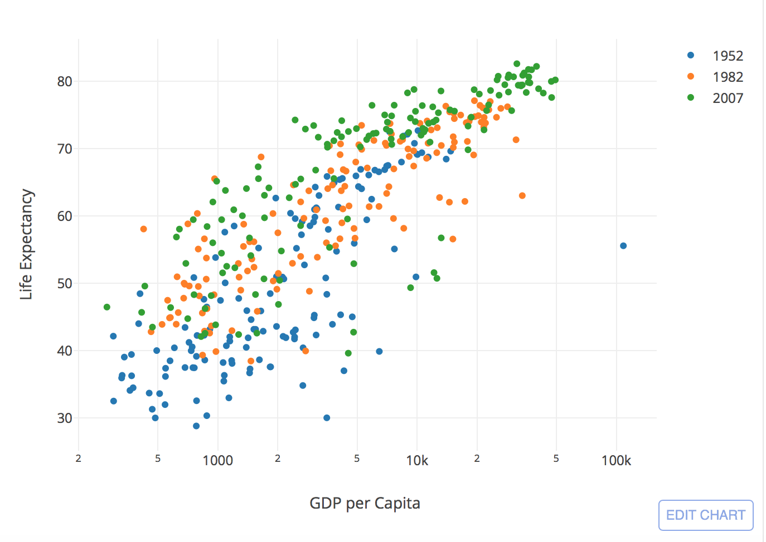
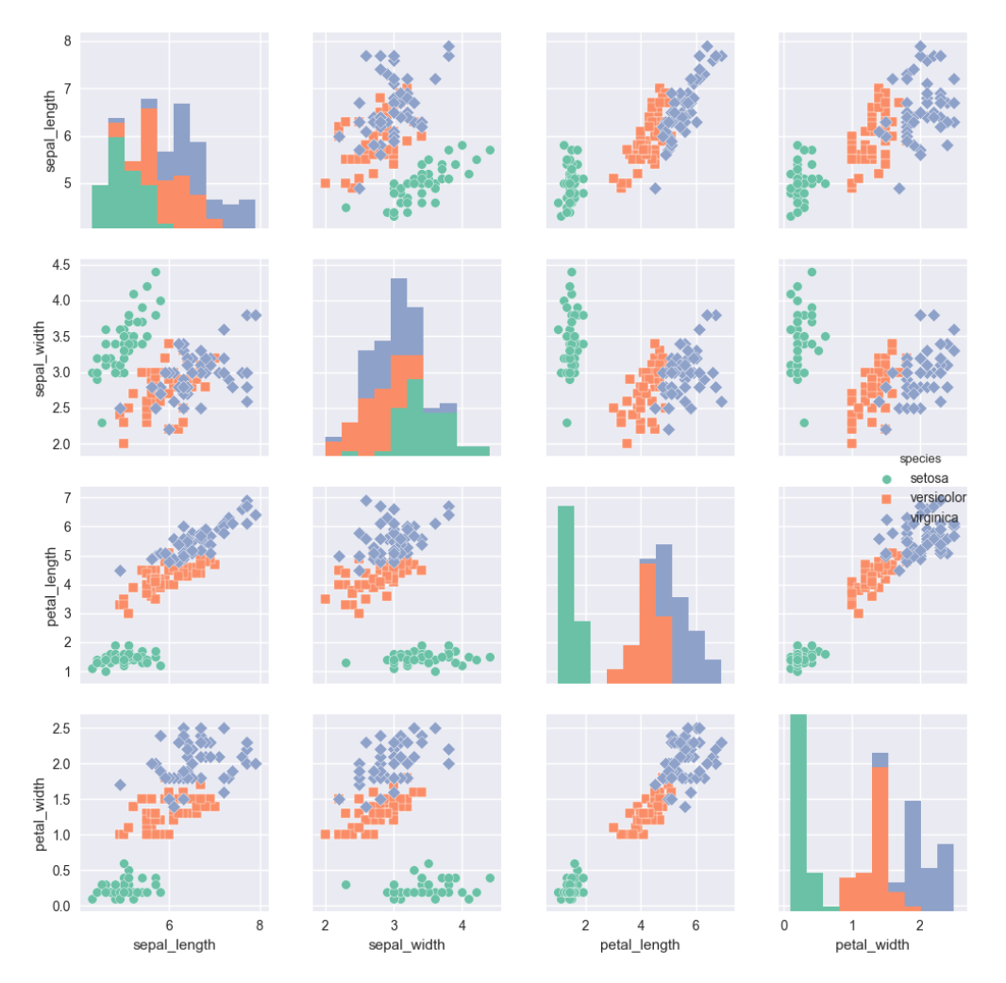
Scatterplot
Connected scatter
Correlogram
Heatmap
https://python-graph-gallery.com

Slide 21
Maps
When to use?
Useful for spatial visualizations

Slide 22
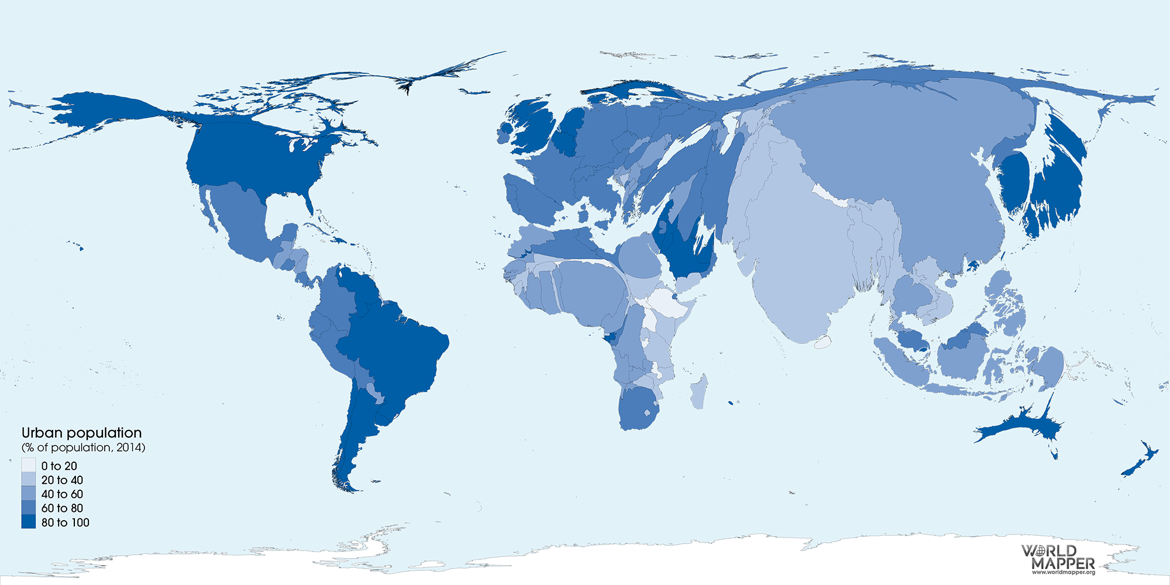
Notes:
More than half of the world’s population lives in cities today. This proportion is expected to increase to 66 per cent by 2050. According to the UN’s World Urbanization Prospects “the urban population of the world has grown rapidly from 746 million in 1950 to 3.9 billion in 2014. Asia, despite its lower level of urbanization, is home to 53 per cent of the world’s urban population, followed by Europe with 14 per cent and Latin America and the Caribbean with 13 per cent. […] Overall, nearly half of the world’s 3.9 billion urban dwellers reside in relatively small settlements with fewer than 500,000 inhabitants, while only around one in eight live in the 28 mega-cities with 10 million inhabitants or more. Many of the fastest growing cities in the world are relatively small urban settlements.”

Slide 23
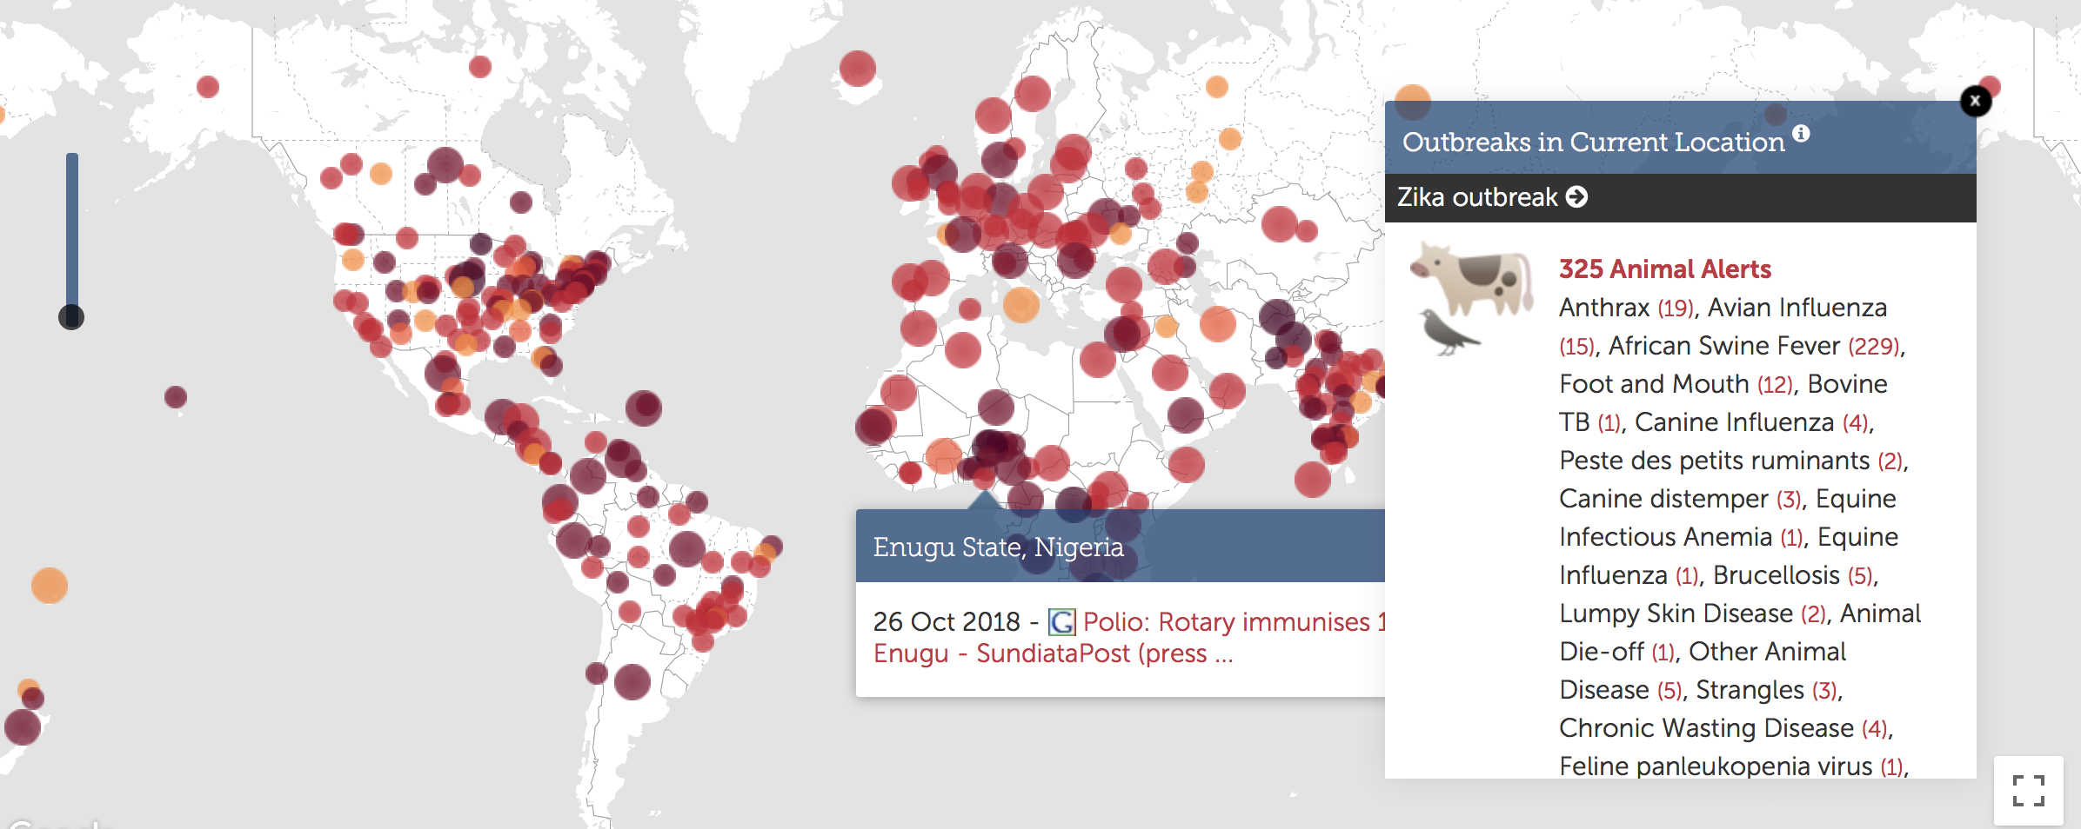
Maps with bubbles
Maps with pins
healthmap.org

Slide 24
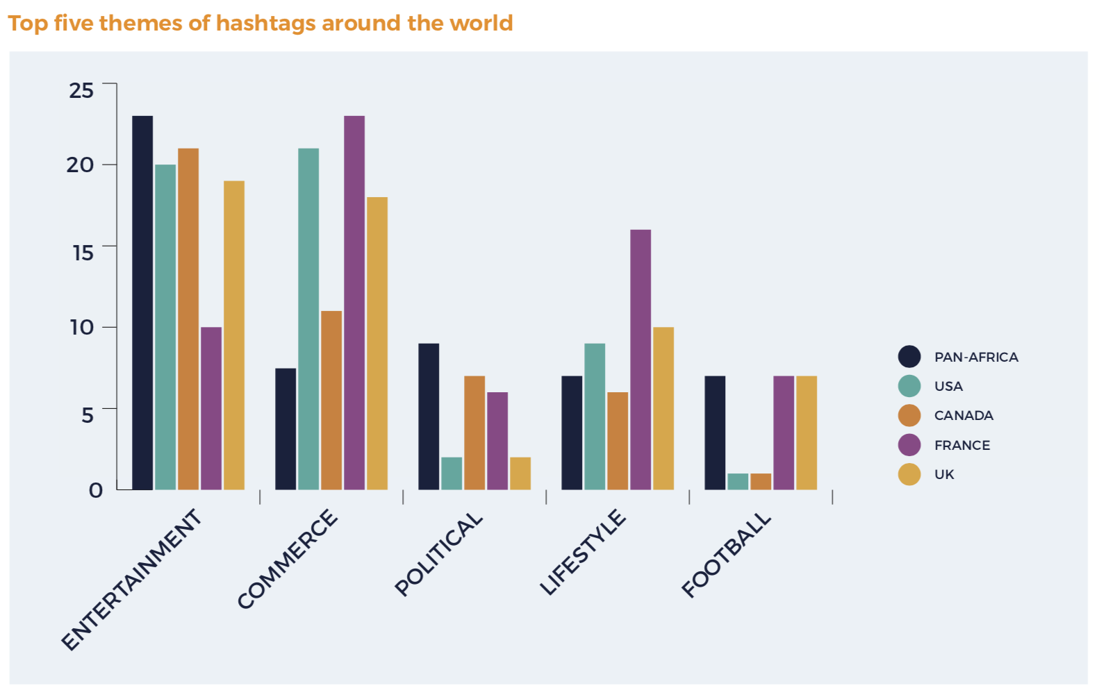
Bar plots
When to use?
Useful for rankings
How Africa Tweets. https://portland-communications.com/publications/how-africa-tweets-2018/

Slide 25
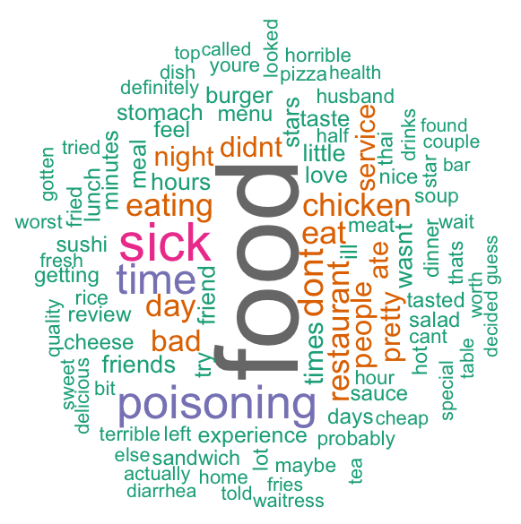
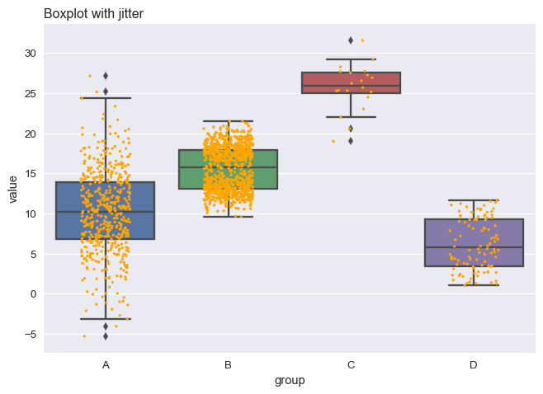
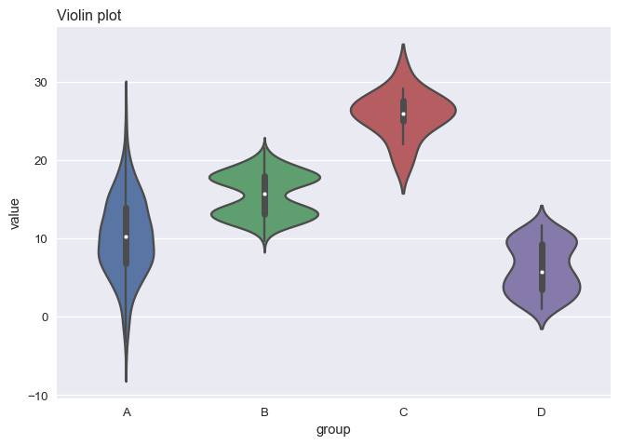
Box plot
Lollipop plot
Word cloud
https://python-graph-gallery.com

Slide 26
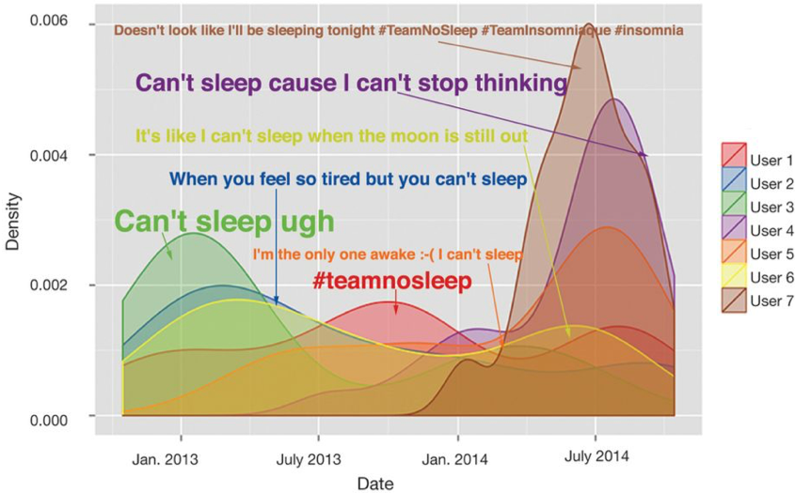
Area/density plots
When to use?
Useful for showing evolution
Jain et al. The Digital Phenotype. Nat Biotech

Slide 27
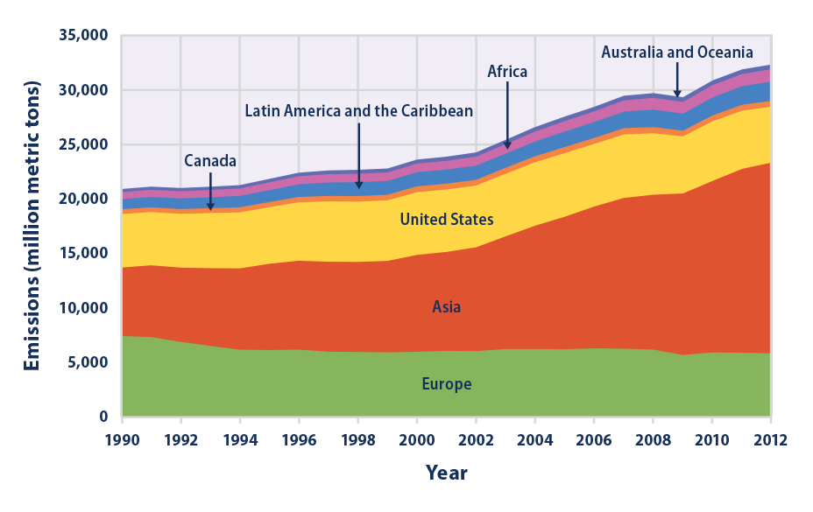
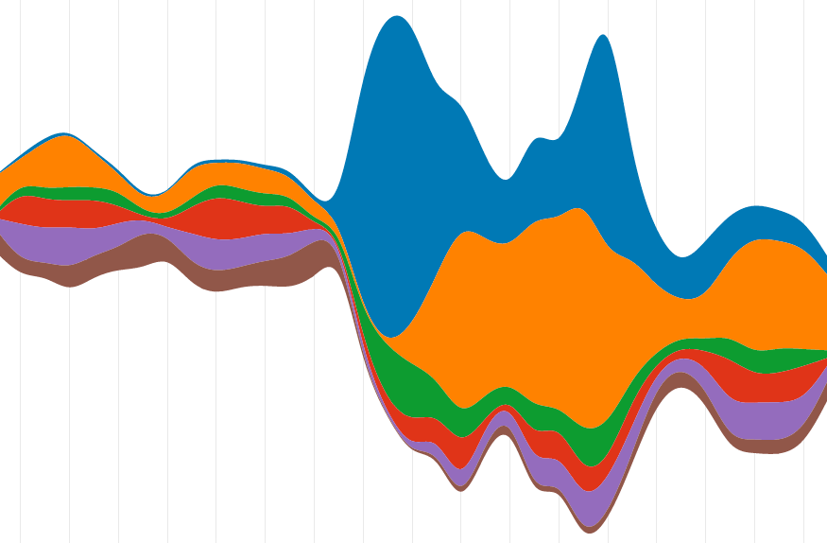
Line plot
(Stacked) area plot
Stream chart
Notes:
Other types of evolution plots. Stacked plot from https://cityofphiladelphia.github.io/climatechangeisreal/climate-indicators/climate-change-indicators-global-greenhouse-gas-emissions/nn. Stream chart from https://flowingdata.com/tag/streamgraph/

Slide 28
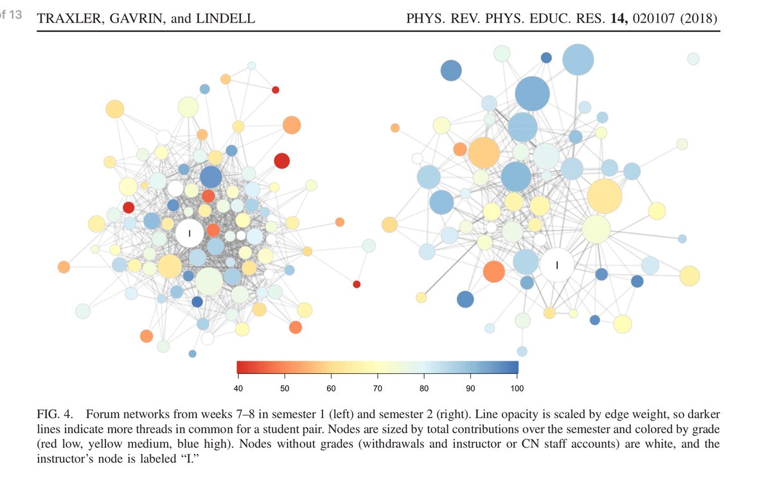
Networks
When to use?
Useful for information flow
Notes:
https://journals.aps.org/prper/abstract/10.1103/PhysRevPhysEducRes.14.020107#

Slide 29
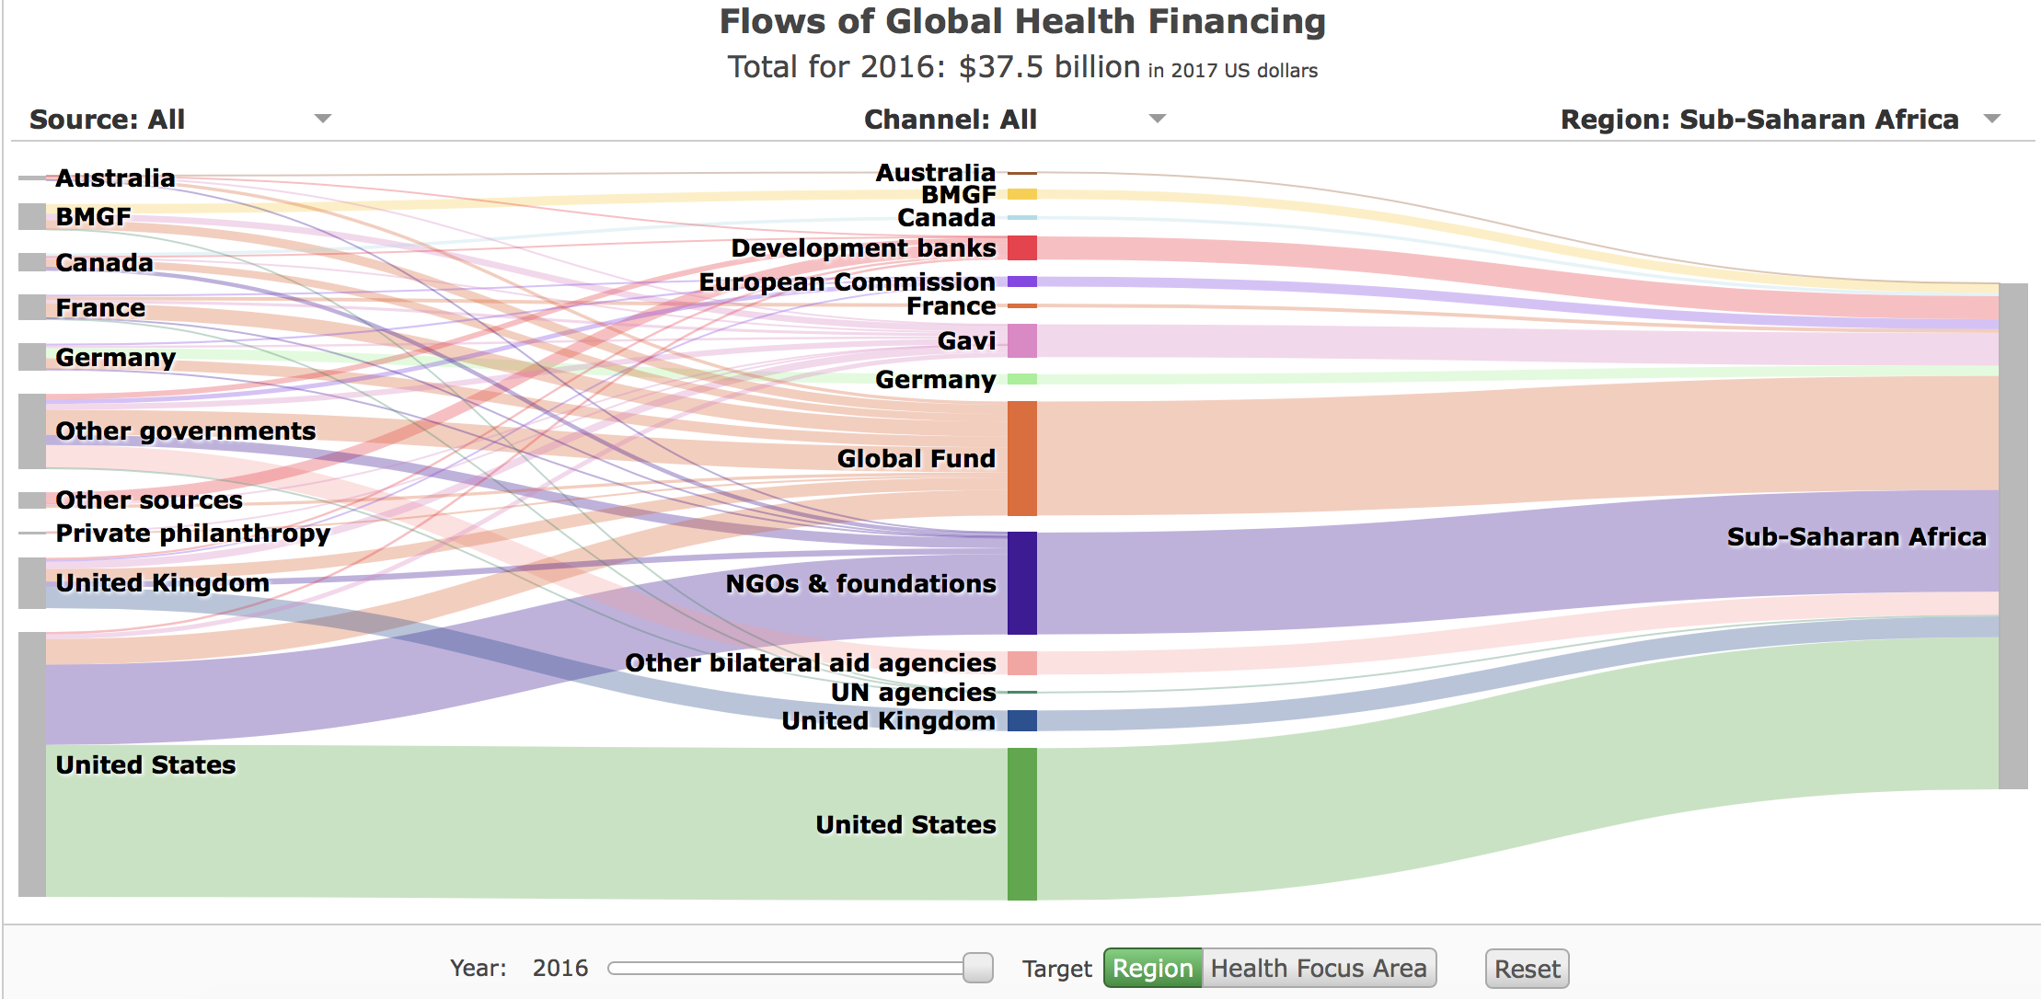
Sankey diagram
https://vizhub.healthdata.org

Slide 30
Code available from:
https://guyabel.com/post/animated-directional-chord-diagrams/
Chord diagram

Slide 31
Bad visualizations

Slide 32
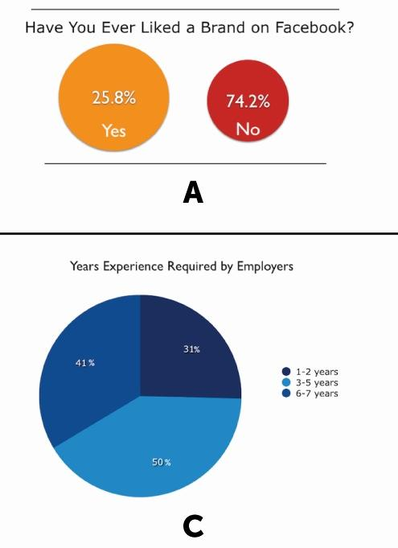
Which of these images has issues?

Slide 33
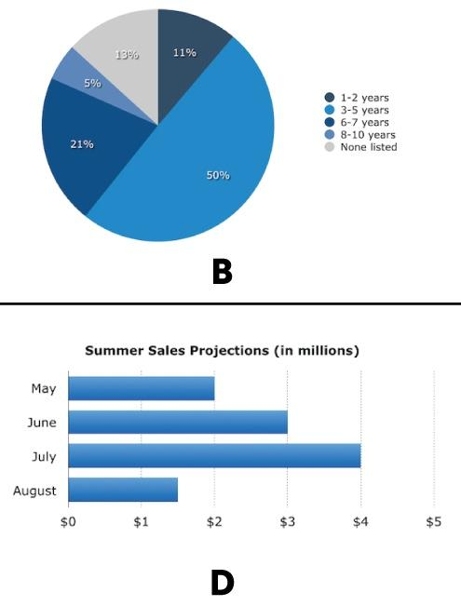
Which of these images has issues?

Slide 34
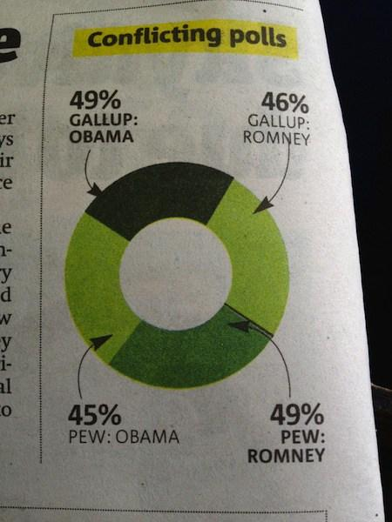
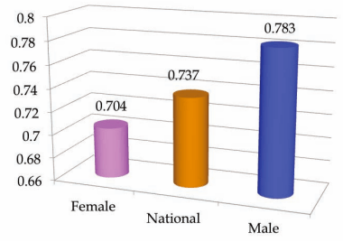
What’s wrong with these images?

Slide 35
Tools and Resources

Slide 36
Python libraries
Matplotlib
ggplot
Seaborn
Bokeh
Pygal
Plotly
Geoplotlib
Gleam
Missingno
Leather
Pydot

Slide 37
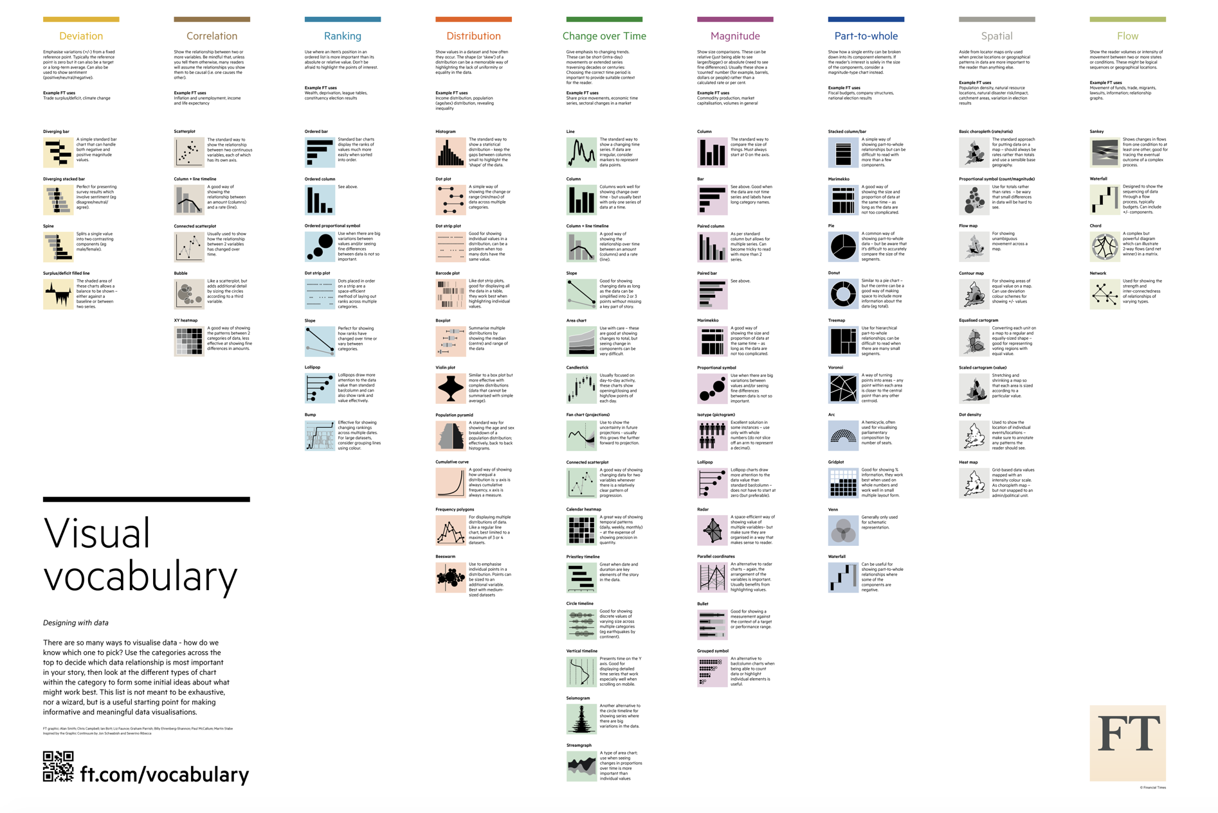
The Chart Doctor
https://github.com/ft-interactive/chart-doctor/tree/master/visual-vocabulary
Notes:
One question that is usually asked when it comes to visualization is; How do I choose the right visualization for my dataset. These are some of the resources that can guide one to decide on a visualization
https://datavizcatalogue.com/
https://depictdatastudio.com/charts/
https://github.com/ft-interactive/chart-doctor/tree/master/visual-vocabulary
Not sure if they fit into this slide

Slide 38
Other tools
Tableau
R ggplot2 and others
D3
Notes:
Replace text with images …

Slide 39
Next ... ipython tutorial

